Slide 1
Random Loading Analysis
Based on paper by Mervyn D. Olson
A Consistent Finite Element Method for Random Response Problems

Slide 2
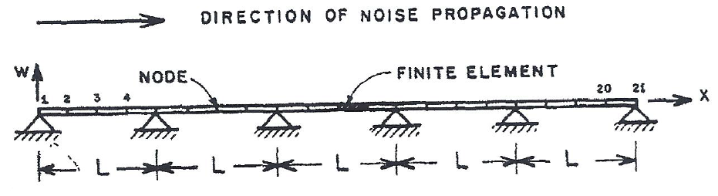

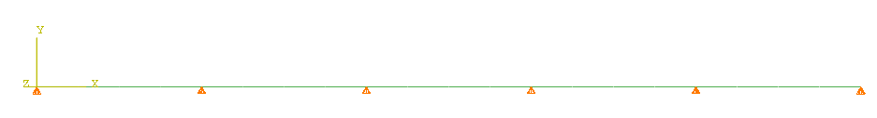
Problem Setup
Random Loading is applied to the beam nodes defined by the cross spectral density defined below.
FEA MODEL
The cross spectral definitions for the nodes is defined in ABAQUS by invoking the PSD definition option under the amplitude option

Slide 3
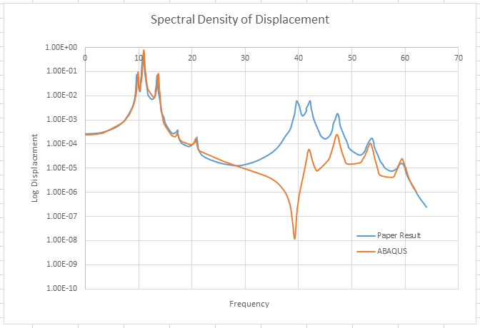
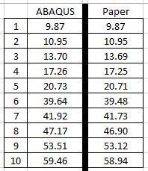
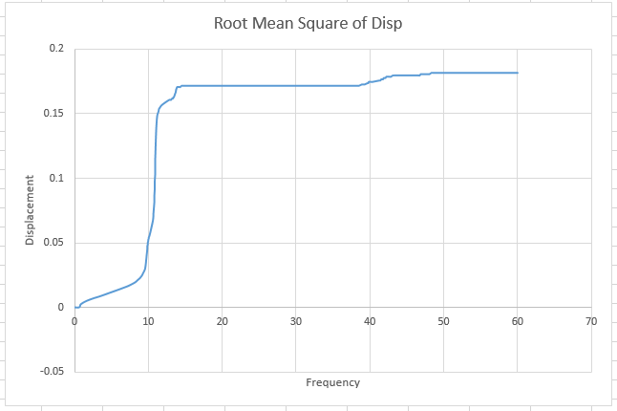
Results

